Slide 1
STUDENT ADMINISTRATION SYSTEM
GROUP 4

Slide 2
Executive summary
Problem Statement
  The current system is inefficient with a fragmented, decentralized database, requiring manual entry of student data, academic records and scheduling
Proposed Solution
  A new robust and multi-functional student management system which streamlines and automates school administrative services.
Benefits
  Automate trivial tasks, reduce manual work, improve data accuracy and integrity, and reduce long term costs

Slide 3
Core Modules
Role based access control.
Student Record Management.
Academic performance & attendance tracking.
Library resource management
Timetable management.
Report generation.
Parent portal.
AI Chatbot.

Slide 4
Student management features
Create new student profile.
Update existing student profile.
Delete existing student profile.
View existing student profiles.
Record student medical information.
Bulk import student profile data.
Bulk export student profile data.
Generate student data report.

Slide 5
Grades management features
Enter student marks.
Update student marks.
Delete student marks.
View student marks.
Generate academic report card.

Slide 6





Technology stack
React.js (TypeScript)
Spring Boot (Java)
OpenAI
PostgreSQL
Amazon Web Services

Slide 7
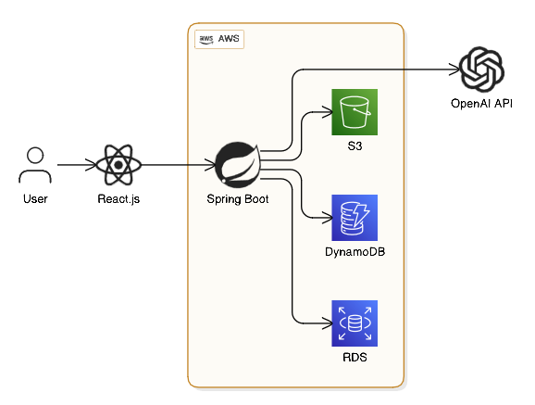
Architecture

Slide 8
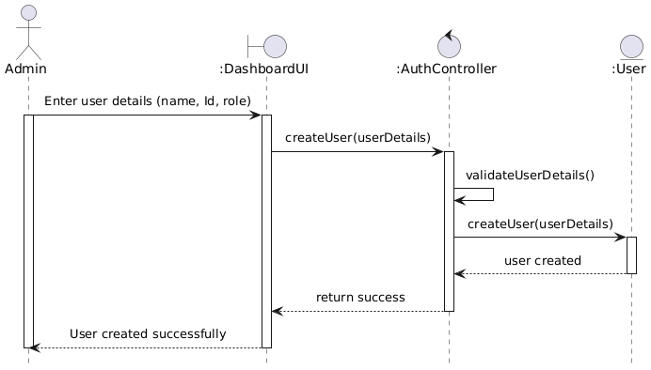
Sequence diagram (create user)

Slide 9
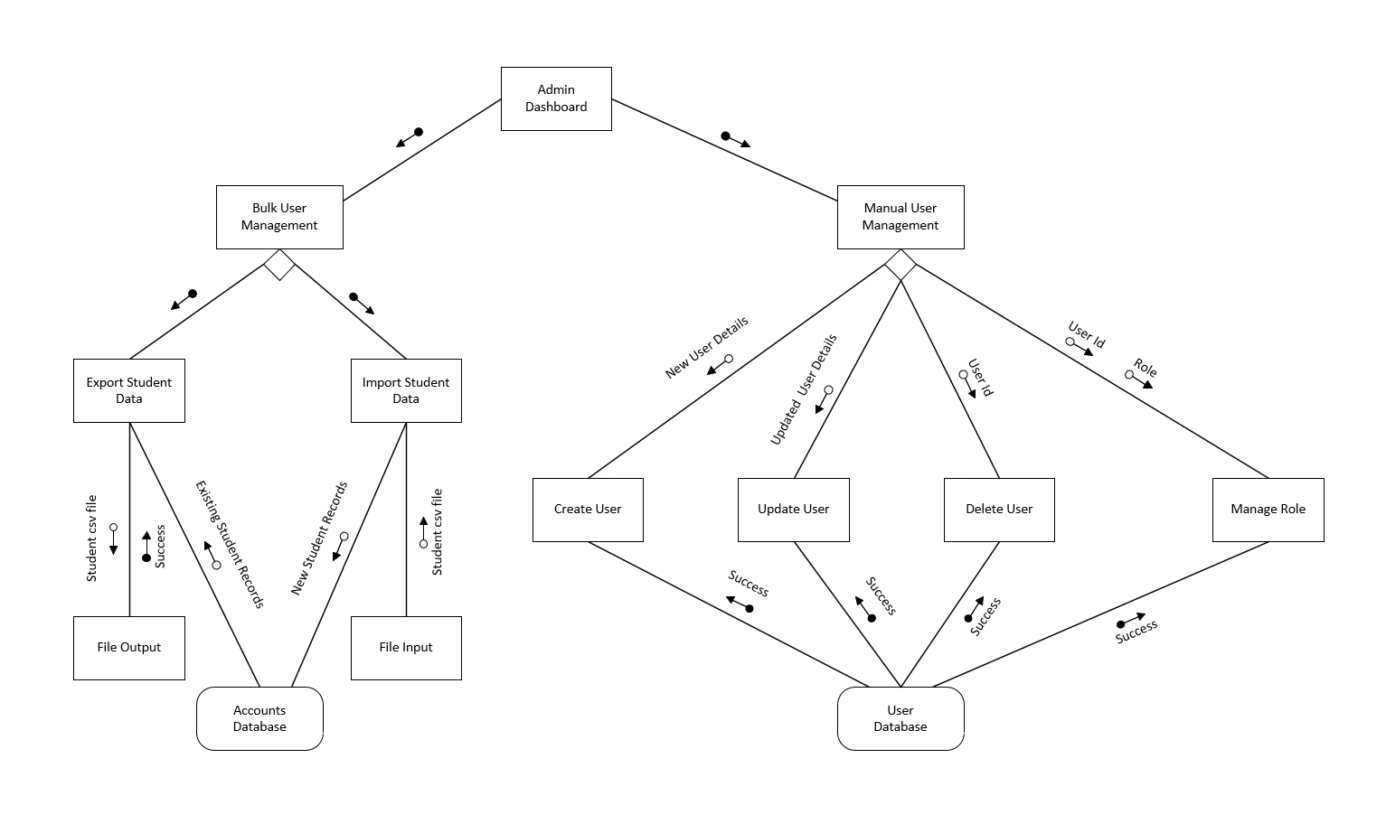
Structure chart (user management)

Slide 10
Entity Relationship Diagram

Slide 11
ERD (Student Info repository)

Slide 12
Data flow Diagram

Slide 13
DFD (account creation)

Slide 14
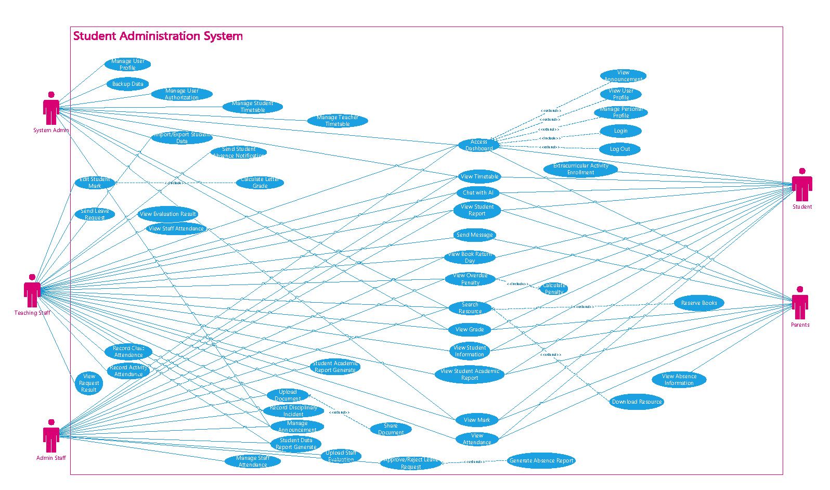
Use case diagram

Slide 15
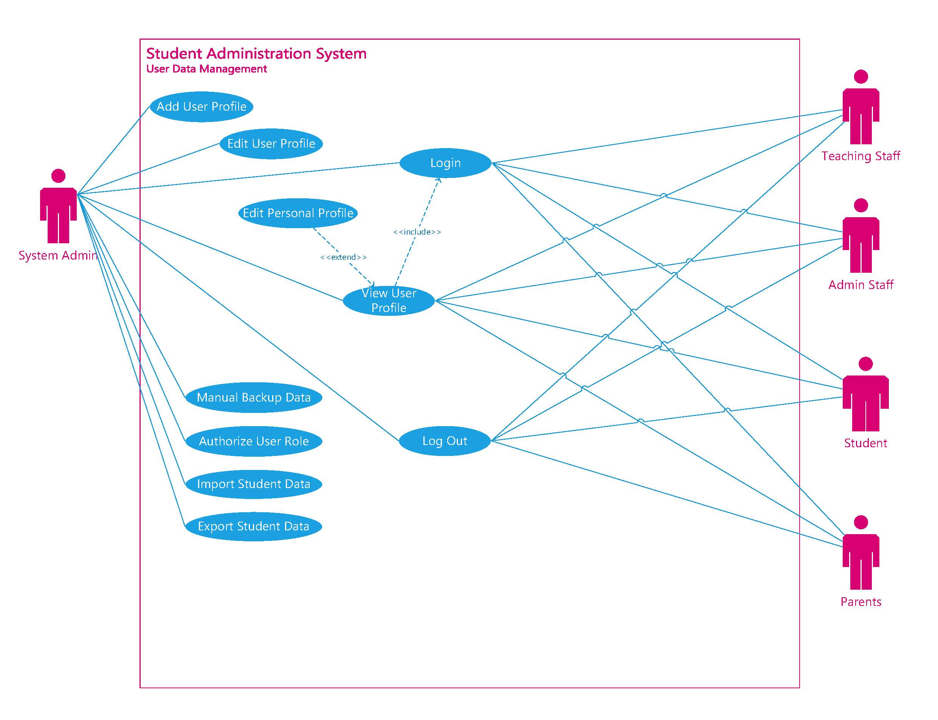
Use case diagram (user management)

Slide 16
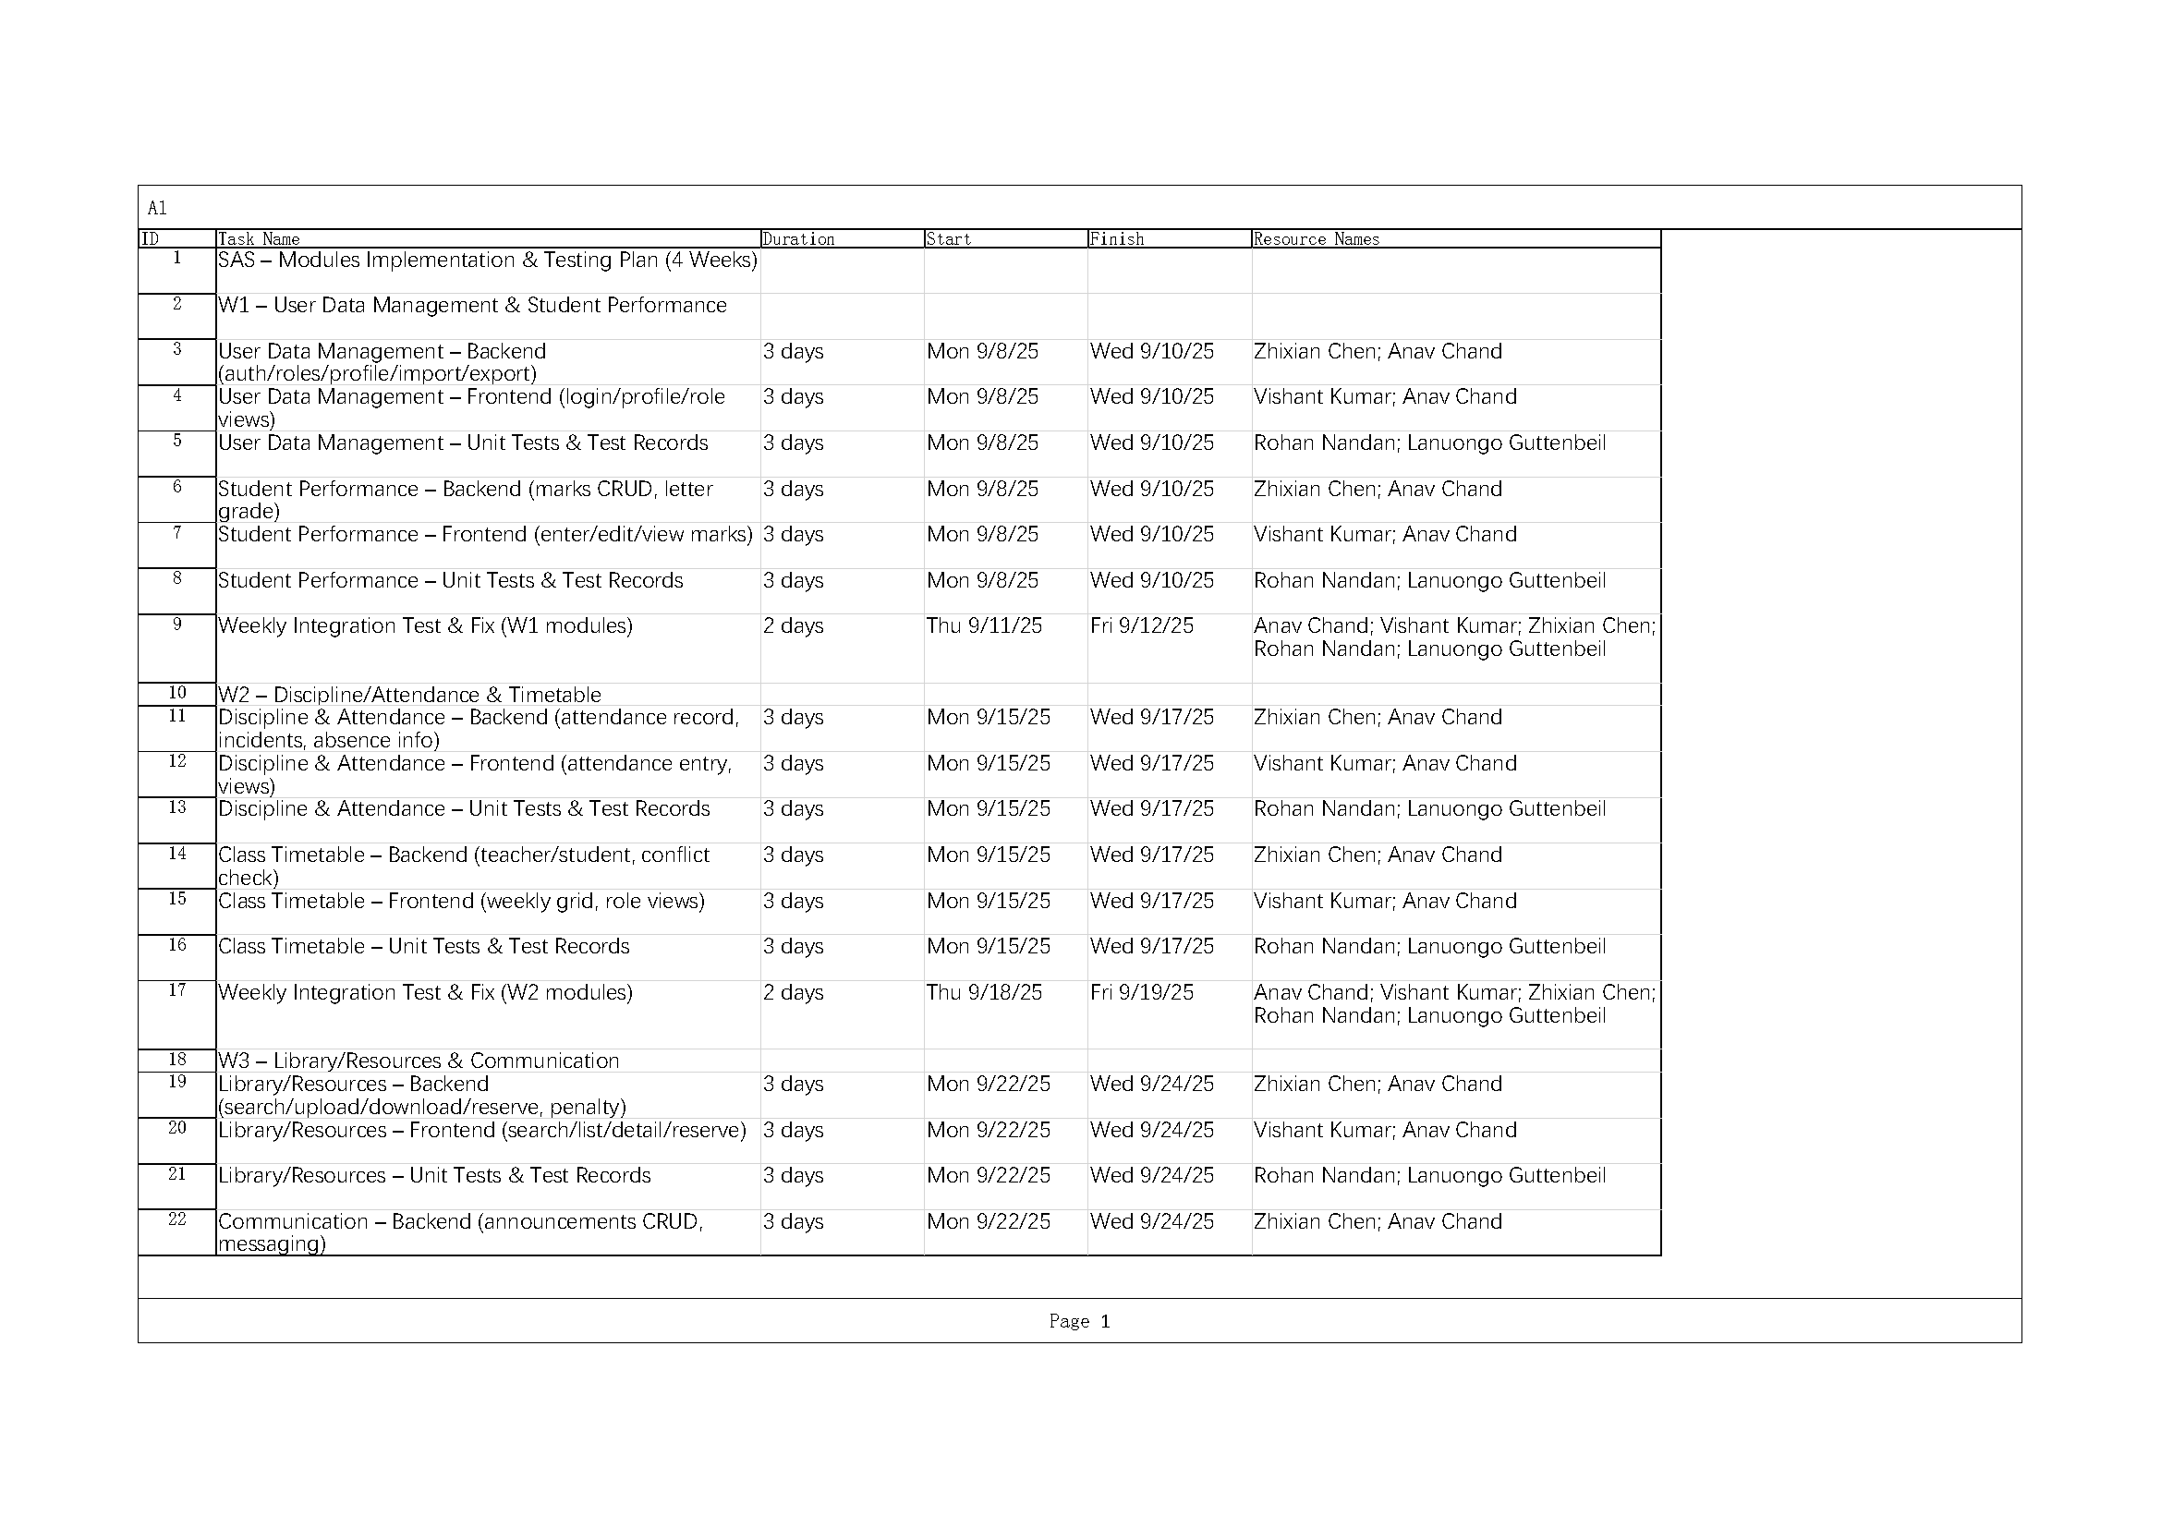
Implementation Plan

Slide 17
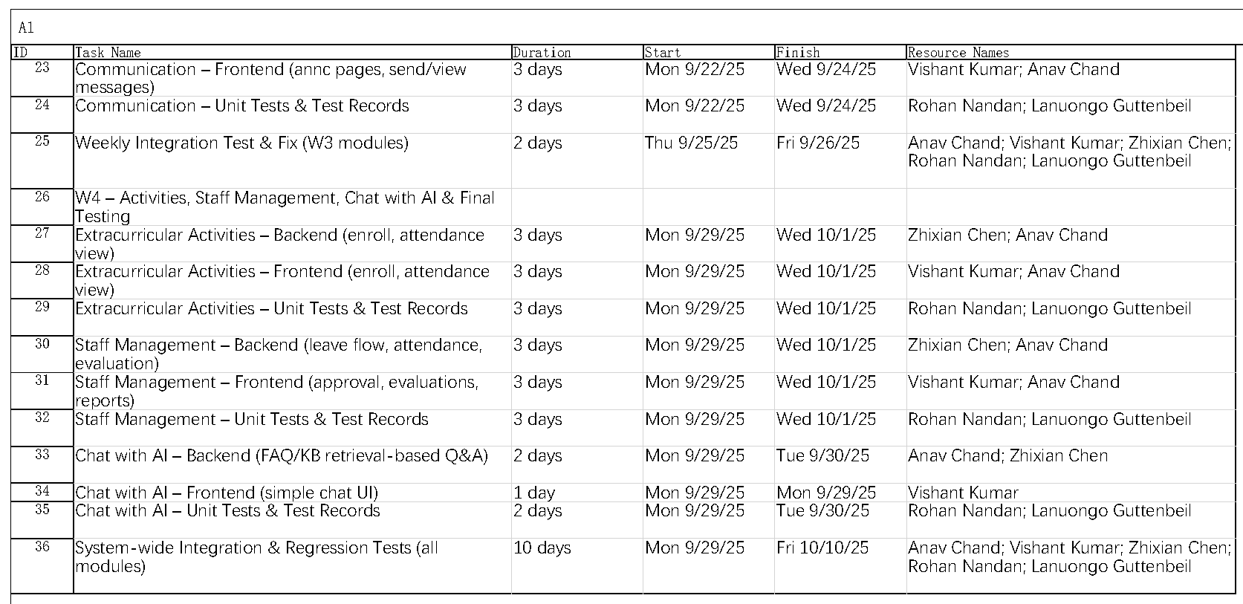
Implementation Plan

Slide 18
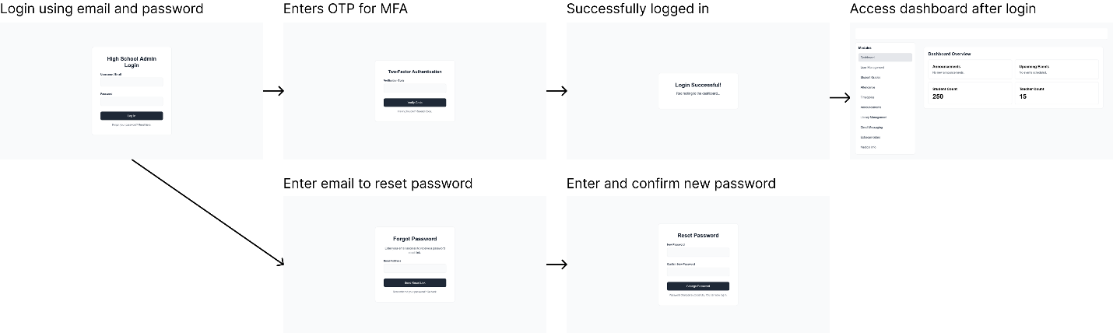
User interfaces
1.1 Authentication Module

Slide 19
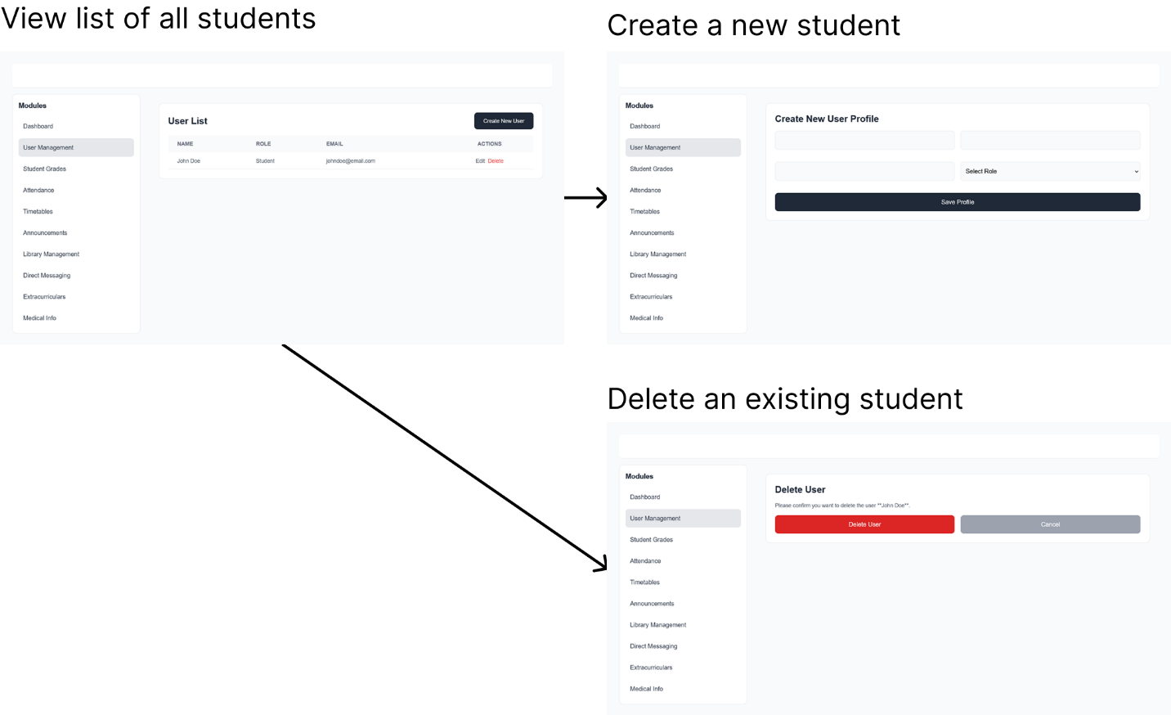
User interfaces
1.2 Student Management Module

Slide 20
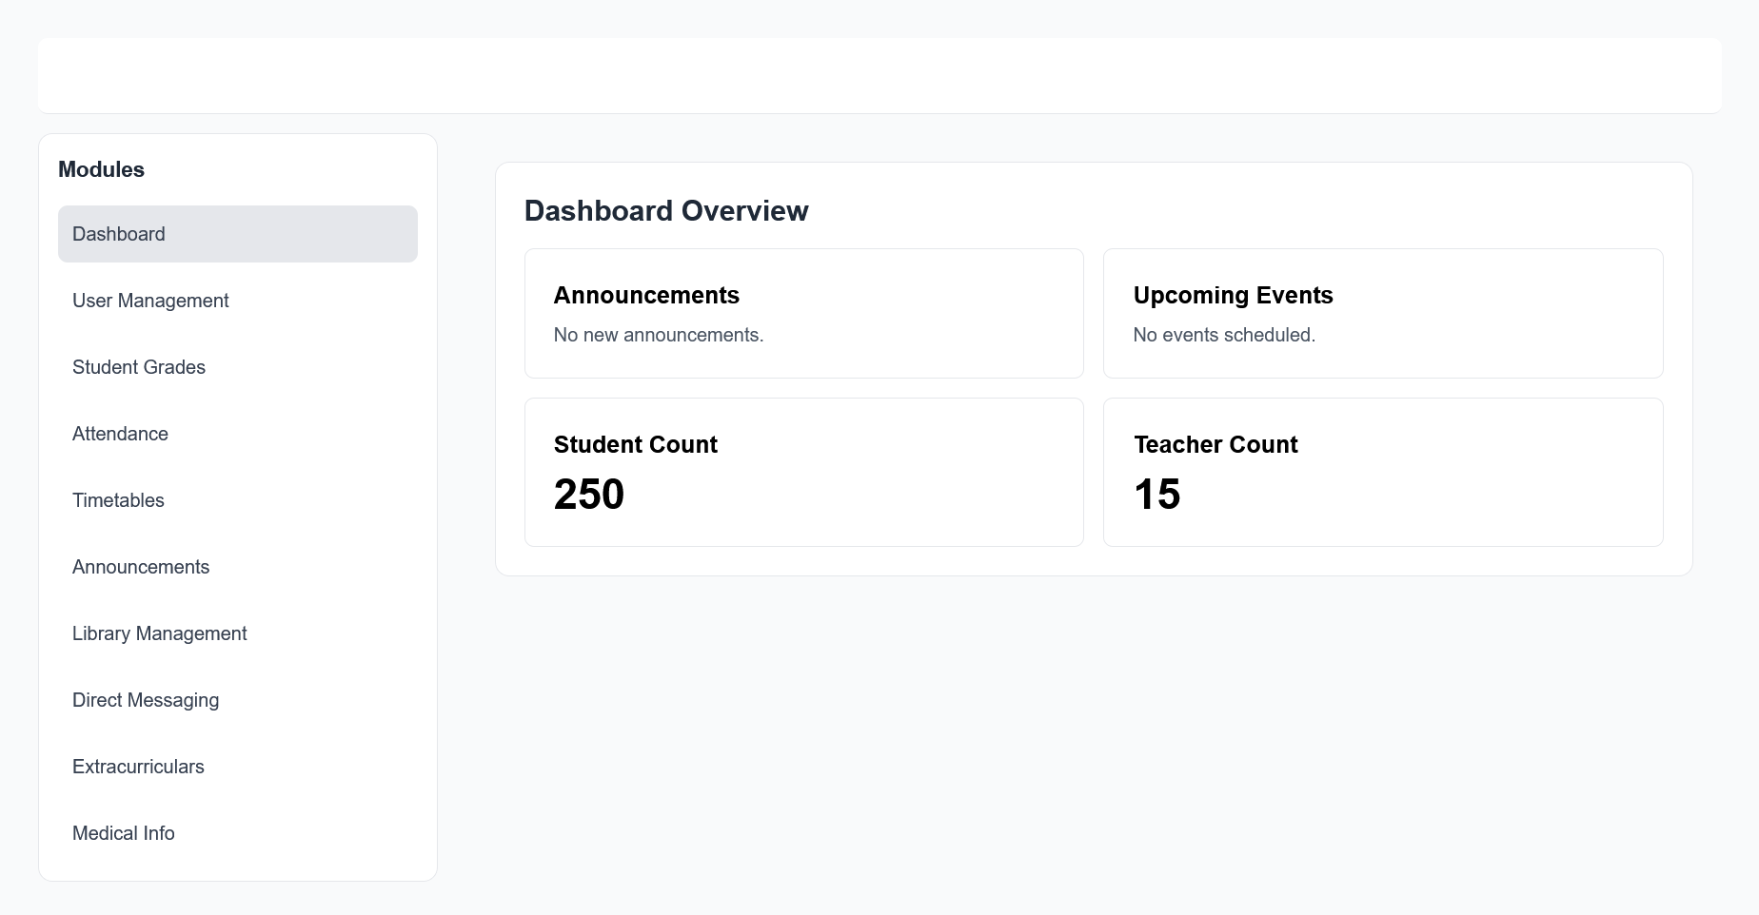
User interfaces
1.3 Dashboard

Slide 21
Summary
Optimized Operation
  Delivers long-term savings by automating processes, improving data accuracy, and boosting administrative efficiency
Secure and Modern
  Built on secure and modern technologies, the system will remain robust and future-proof.
User-First Design
  Integrated AI chatbot provides immediate support for queries along with user-friendly interface to guide and navigate users.

